Slide 1
Branch Prediction

Slide 2
Microprocessor Implementation Basics
Microprocessor runs your programs
High-level language statements translated to machine language
Machine languages is very simple
E.g. “branch to another instruction,” “load a value from memory,” “add these two values together,” etc.
Different variables all mapped to distinct addresses in a large memory
Processors go to great lengths to provide good performance
Make slow memories seem fast
Run sequential programs in parallel out-of-order
Processors use a fast “clock” to control timing of instructions
One clock tick (cycle) might be 1/3 nanosecond

Slide 3
Processors Rely on Speculation
Branch instructions
Branch outcome unknown for many cycles because parallel
But the processor must be continually fed to exploit pipelining
Pipelining is enabled by branch prediction
Instructions are speculatively executed on the predicted path

Slide 4
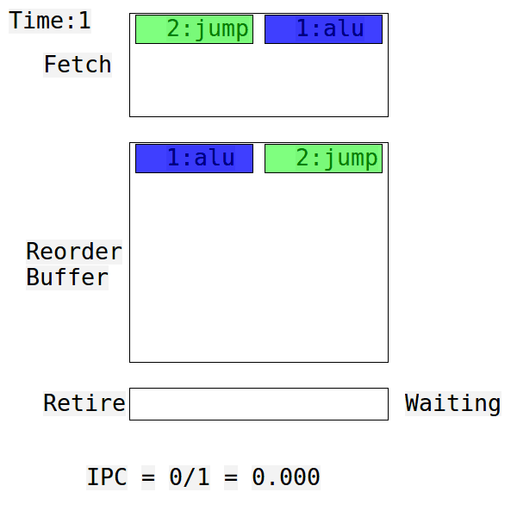
Superscalar Out-of-Order Execution
Instructions are fetched in-order
Executed out-of-order
Wait for values in a queue
Execute when ready
Fast instructions skip past slow ones
Retired in-order

Slide 5
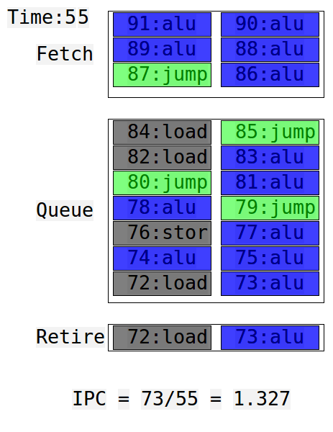
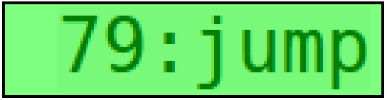
Problem Instructions: Branches
The next instruction to fetch is not known until branch is executed
Branch prediction enables speculative fetching and execution beyond branches, but…

Slide 6
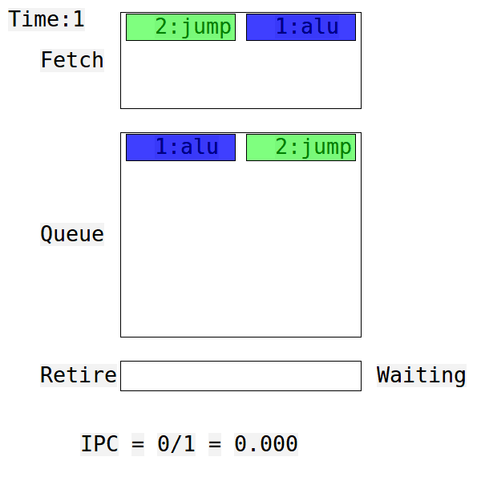
Waste from Branch Speculation
Mispredicted branches waste significant time and energy
Mis-speculated instructions are dropped and don’t contribute to performance
Improving accuracy a little improves performance a lot
E.g. halving average MPKI from 6.5 to 3.25 would improve Intel Core 2 performance by 13%; 0 MPKI would yield 26% [IISWC 2011]

Slide 7

Reducing Wasted Time & Energy: Better Branch Prediction

Slide 8
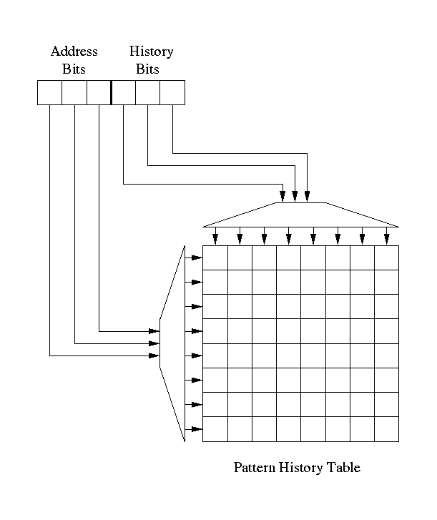
Conditional Branch Prediction
Most predictors based on 2-level adaptive branch prediction [Yeh & Patt ’91]
Branch outcomes shifted into history register, 1=taken, 0=not taken
History bits and address bits combine to index a pattern history table (PHT) of 2-bit saturating counters
Prediction is high bit of counter
Counter is incremented if branch is taken, decremented if branch is not taken
Branches tend to be highly biased
Last 20 years of research focus on accuracy
GAs – a common type of predictor

Slide 9
My Idea: Use Neural Learning
Neural learning for predicting branches is a natural fit
Input is history of branches – taken/not taken
Outut is binary: predict taken or not taken
First idea: perceptron predictor [Jimenez&Lin 2001]
Neural-inspired branch predictors the most accurate in the literature
Dynamically train perceptrons to predict conditional branches
Addressing problems with perceptron and other predictors
Latency – ahead pipelining [HPCA 2003,MICRO 2003,TOCS 2005, etc.]
Linear inseparability – piecewise linear prediction [ISCA 2005,JILP 2005]
Power – analog neural predictor [MICRO 2008,IEEE Micro“Top Picks” 2009]
Accuracy – improved organization [ ICCD 2011 ]

Slide 10
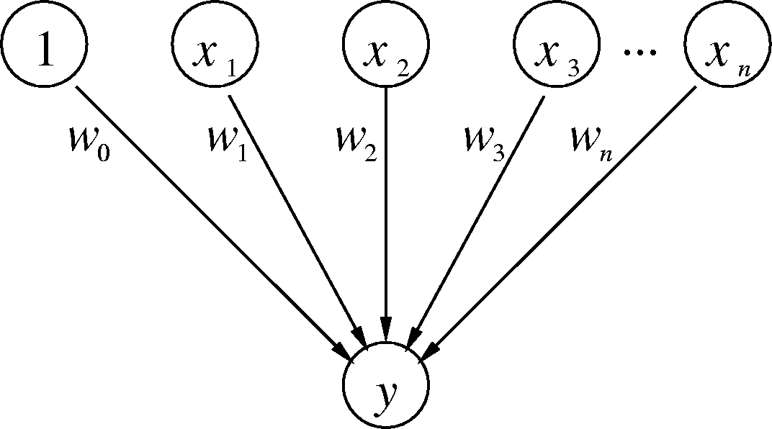
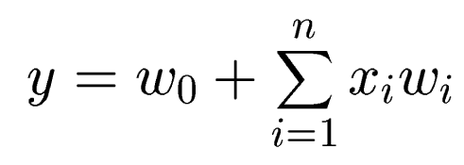
Branch-Predicting Neuron
Inputs (x’s) are from branch outcome history – taken or not taken
n + 1 small integer weights (w’s) learned by on-line training
Output (y) is dot product of x’s and w’s; predict taken if y ≥ 0
Training finds correlations between history and outcome
Dot-product computation has high latency and power

Slide 11
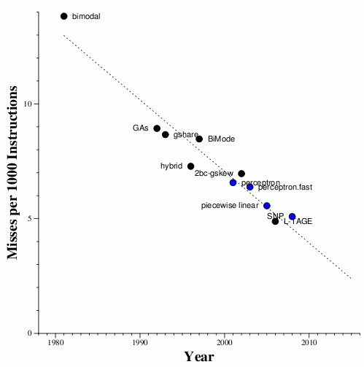
Accuracy Is Improving

Slide 12
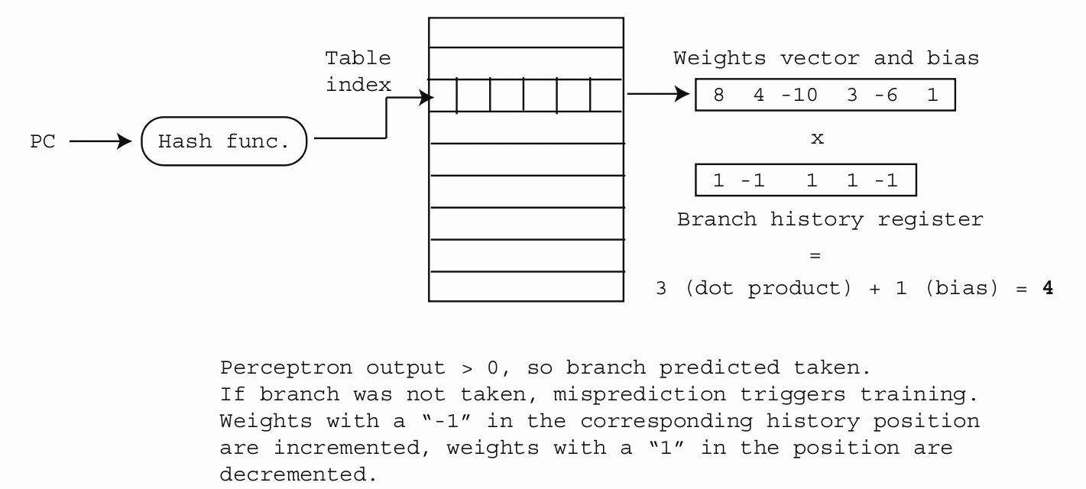
Branch Prediction with Perceptrons

Slide 13
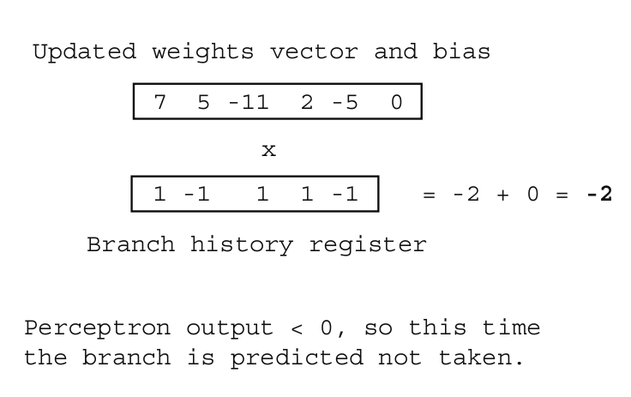
Branch Prediction with Perceptrons cont.

